Slide 1


meta-flatpak
Flatpak in Yocto, Yocto in Flatpak

Slide 2
Contents
Flatpak
Flathub
meta-flatpak
  Flatpak in Yocto
  Yocto in Flatpak
Summary
Notes:
Name of a project, and also the name of the build output of the project

Slide 3
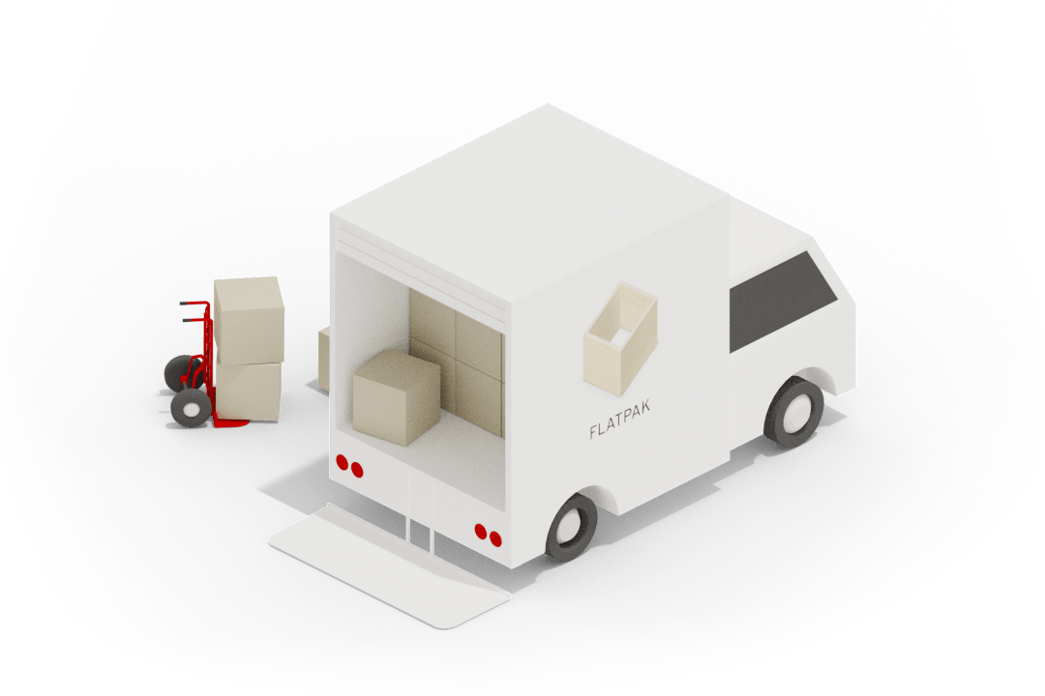
Flatpak
Solution for app packaging, distribution and sandboxing.
App/runtime split.
OSTree-based
Notes:
Name of a project, and also the name of the build output of the project

Slide 4
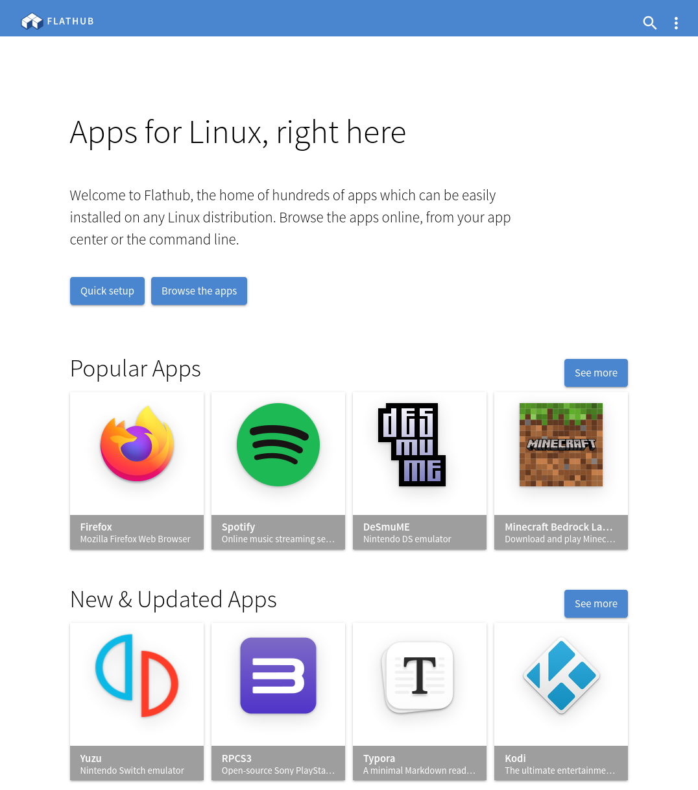
Flathub
1,407 desktop/mobile apps ready to run on your device.
Or… create your own runtime and your own ecosystem of apps.

Slide 5
meta-flatpak
Created by Intel in 2016, maintained 2016-2017 as part of https://github.com/intel/intel-iot-refkit
Updated by Codethink in 2021, and now moved to https://github.com/flatpak/meta-flatpak
Goal: enable Flatpak in Automotive Grade Linux.
Notes:
Name of a project, and also the name of the build output of the project

Slide 6
Flatpak in Yocto
Instructions from AGL.md.
Step 1: add layers
bitbake-layers add-layer
meta-openembedded/meta-oe
meta-openembedded/meta-gnome
meta-openembedded/meta-filesystems
meta-openembedded/meta-networking
meta-flatpak

Slide 7
Flatpak in Yocto
Instructions from AGL.md.
Step 2: update local.conf
# Include flatpak in the image.
IMAGE_INSTALL_append = " flatpak”
# Make sure we get the necessary dependencies
DISTRO_FEATURES_append = " wayland seccomp"
# Include configuration from this repo
include conf/distro/include/flatpak-applications.inc
Make sure your rootfs has 1GB or more free for apps & runtimes.

Slide 8
Video demo
https://www.youtube.com/watch?v=6k4jNcmvlWk

Slide 9

I want to build a runtime...
A Flatpak runtime is a container image of runtime dependencies, with Flatpak-specific metadata, delivered using OSTree.
A Flatpak SDK is the same with build dependencies + devtools.
Most apps use Freedesktop, GNOME or KDE runtimes:
originally built with Yocto
later bootstrapped independently using Buildstream

Slide 10
Yocto in Flatpak
SDK and runtime must be a separate targets.
Minimal example (see core-image-flatpak-runtime.bb):
include ../meta/recipes-core/images/core-image-minimal.bb
IMAGE_FSTYPES = ""
inherit flatpak-image

Slide 11
Thanks for listening!
Visit: https://github.com/flatpak/meta-flatpak
Questions?
https://codethink.co.uk

